Slide 1
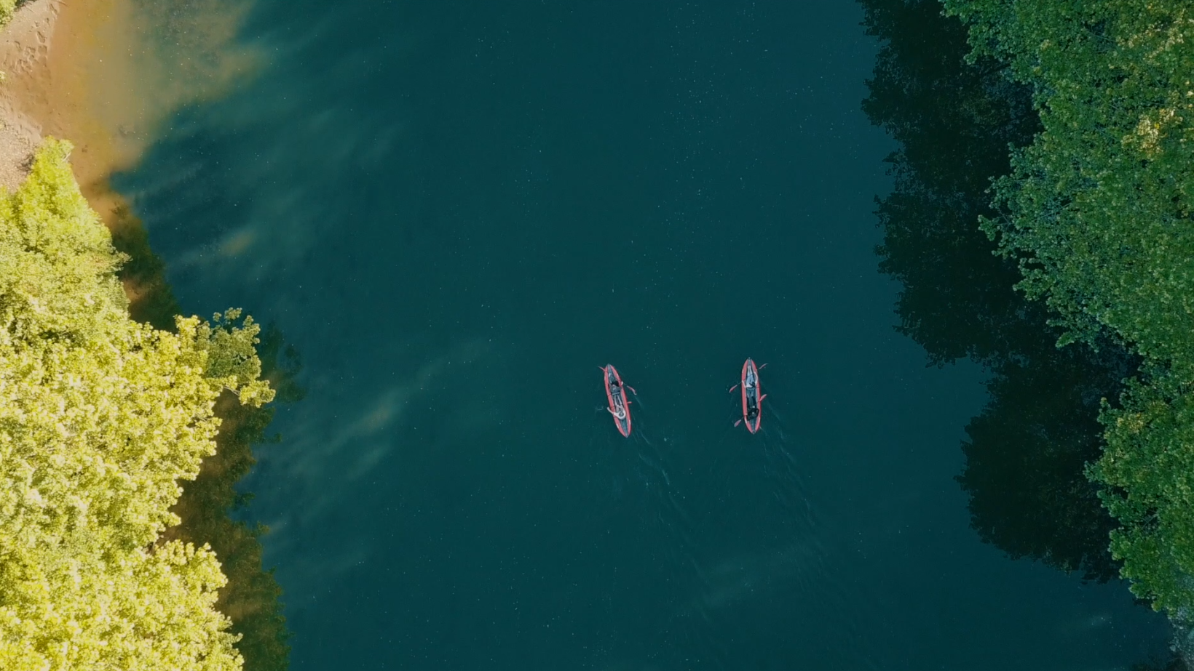


^{Plastic Origins}
A citizen science project using AI to map river plastic pollution

Slide 2
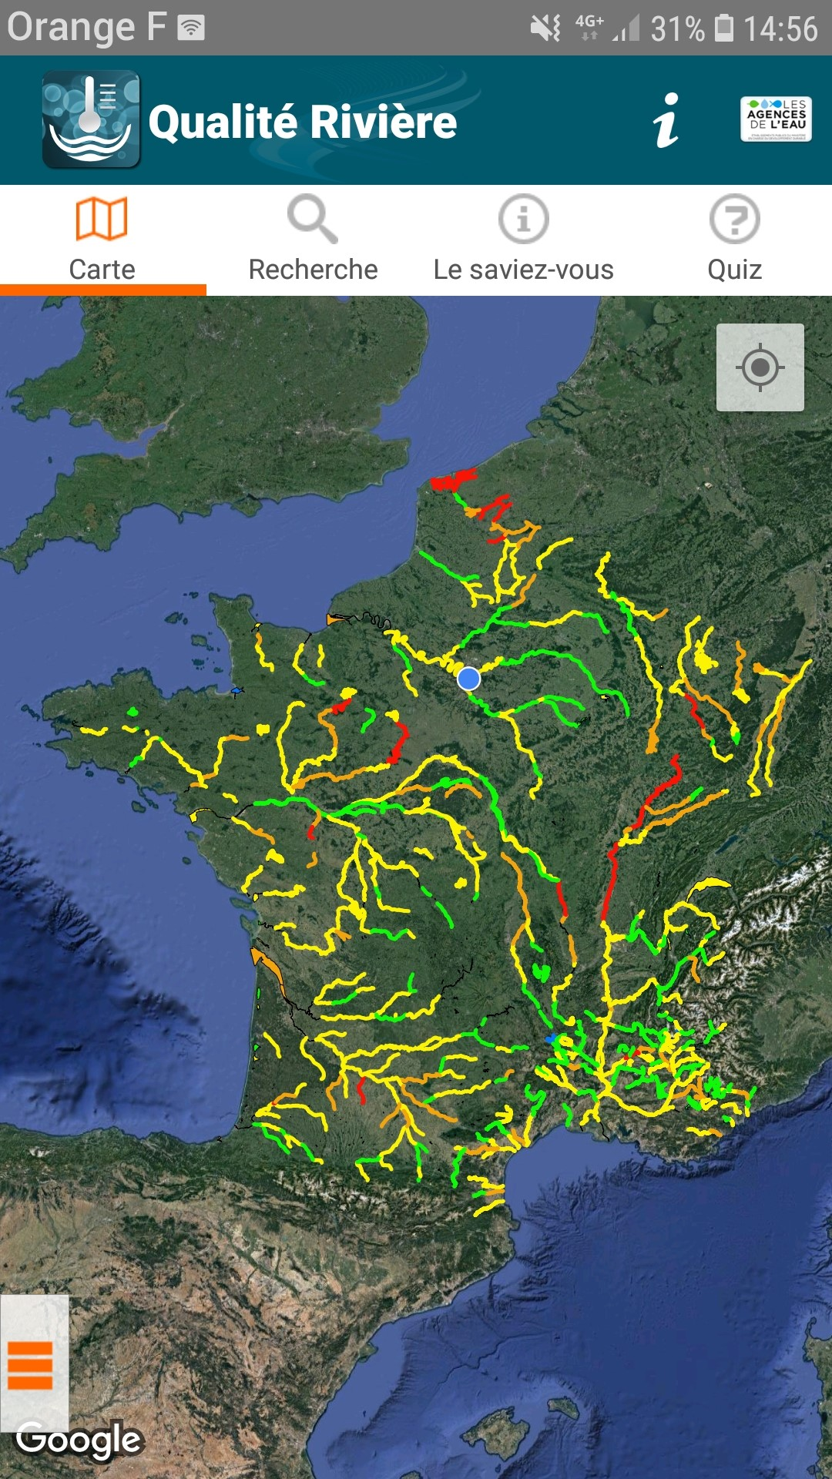
Our need / Goal
Why ?
So we know where to act
To help decision makers to take action where it is really needed
To track improvements

Slide 3
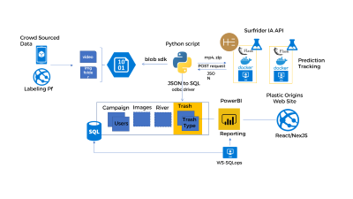
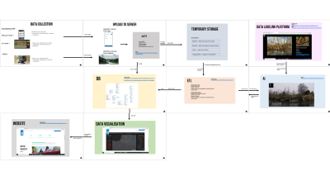
All you need to know to get involved !

Slide 4











Surfrider IA API
Crowd Sourced Data
Python script
video
blob sdk
mp4, zip
Prediction
Tracking
POST request
Img folder
JSON
JSON to SQL
Labeling Pf
odbc driver
Plastic Origins
Web Site
PowerBI
Campaign
Images
River
Trash
Users
Trash
Type
Reporting
React/NexJS
WS-SQLops

Slide 5
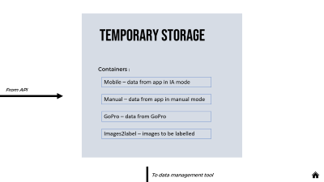
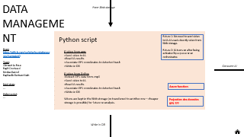
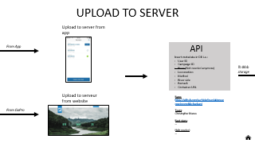
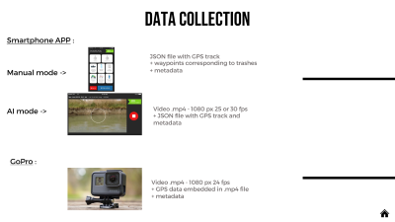
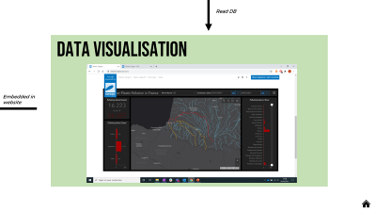
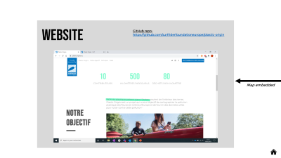
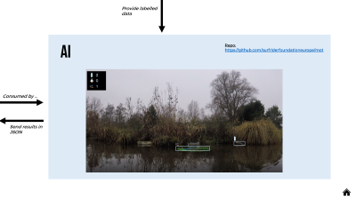
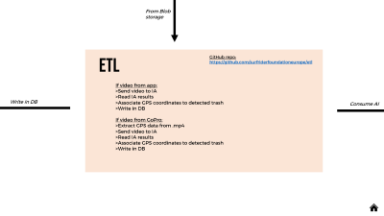
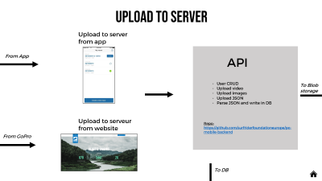
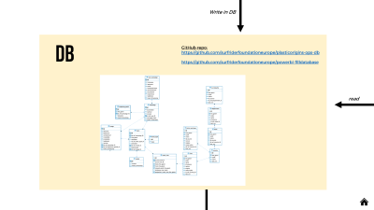
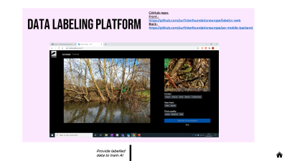
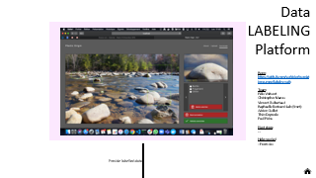
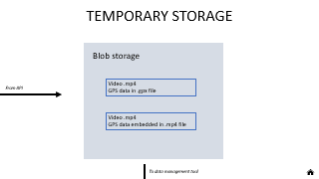
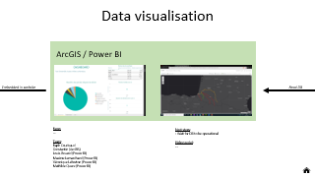
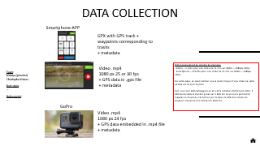
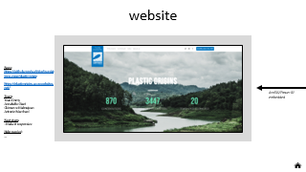

Slide 6
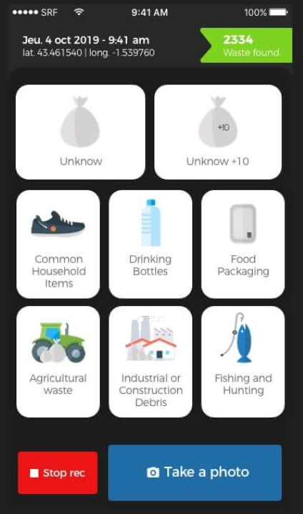
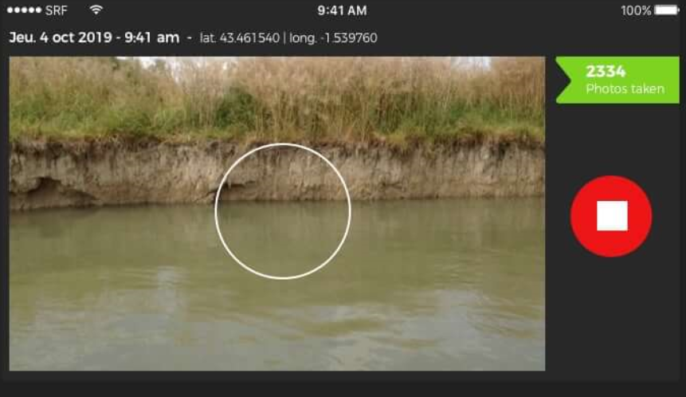
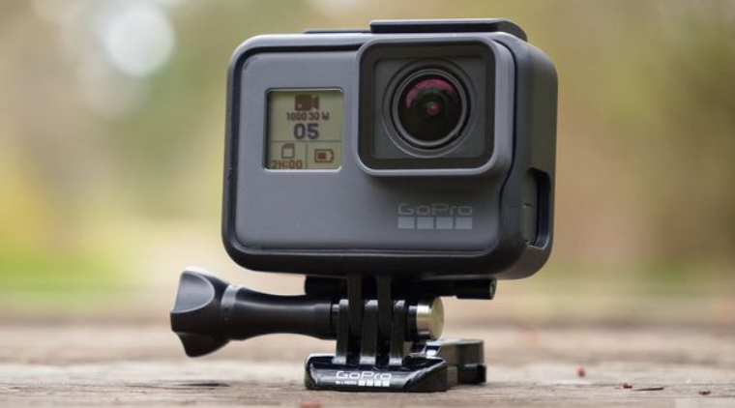

DATA COLLECTION
Smartphone APP :
JSON file with GPS track
+ waypoints corresponding to trashes
+ metadata
Manual mode ->
AI mode ->
Video .mp4 - 1080 px 25 or 30 fps
+ JSON file with GPS track and metadata
GoPro :
Video .mp4 - 1080 px 24 fps
+ GPS data embedded in .mp4 file
+ metadata

Slide 7
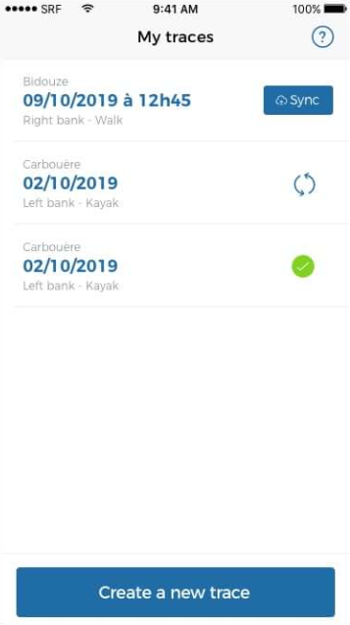
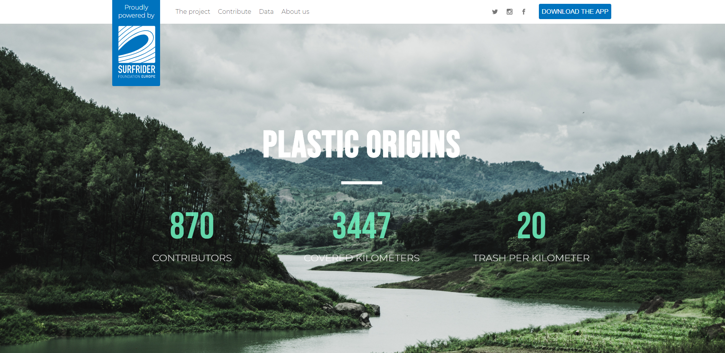
UPLOAD TO SERVER
Upload to server from app
From App
API
User CRUD
Upload video
Upload images
Upload JSON
Parse JSON and write in DB
To Blob storage
Upload to serveur from website
Repo:
https://github.com/surfriderfoundationeurope/po-mobile-backend
From GoPro
To DB

Slide 8
TEMPORARY STORAGE
Containers :
Mobile – data from app in IA mode
From API
Manual – data from app in manual mode
GoPro – data from GoPro
Images2label – images to be labelled
To data management tool

Slide 9
From Blob storage
ETL
GitHub repo:
https://github.com/surfriderfoundationeurope/etl
If video from app:
>Send video to IA
>Read IA results
>Associate GPS coordinates to detected trash
>Write in DB
If video from GoPro:
>Extract GPS data from .mp4
>Send video to IA
>Read IA results
>Associate GPS coordinates to detected trash
>Write in DB
Write in DB
Consume AI

Slide 10
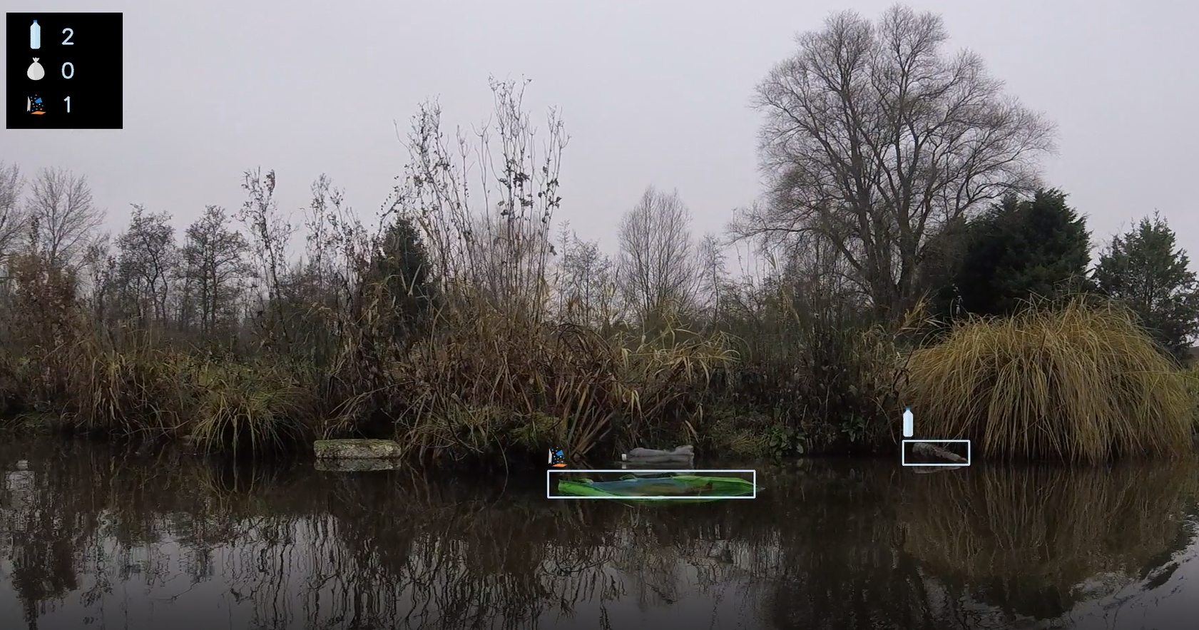
Provide labelled data
AI
Repo:
https://github.com/surfriderfoundationeurope/mot
Consumed by …
Send results in JSON

Slide 11
From Blob storage
ETL
GitHub repo:
https://github.com/surfriderfoundationeurope/etl
If video from app:
>Send video to IA
>Read IA results
>Associate GPS coordinates to detected trash
>Write in DB
If video from GoPro:
>Extract GPS data from .mp4
>Send video to IA
>Read IA results
>Associate GPS coordinates to detected trash
>Write in DB
Write in DB
Consume AI

Slide 12
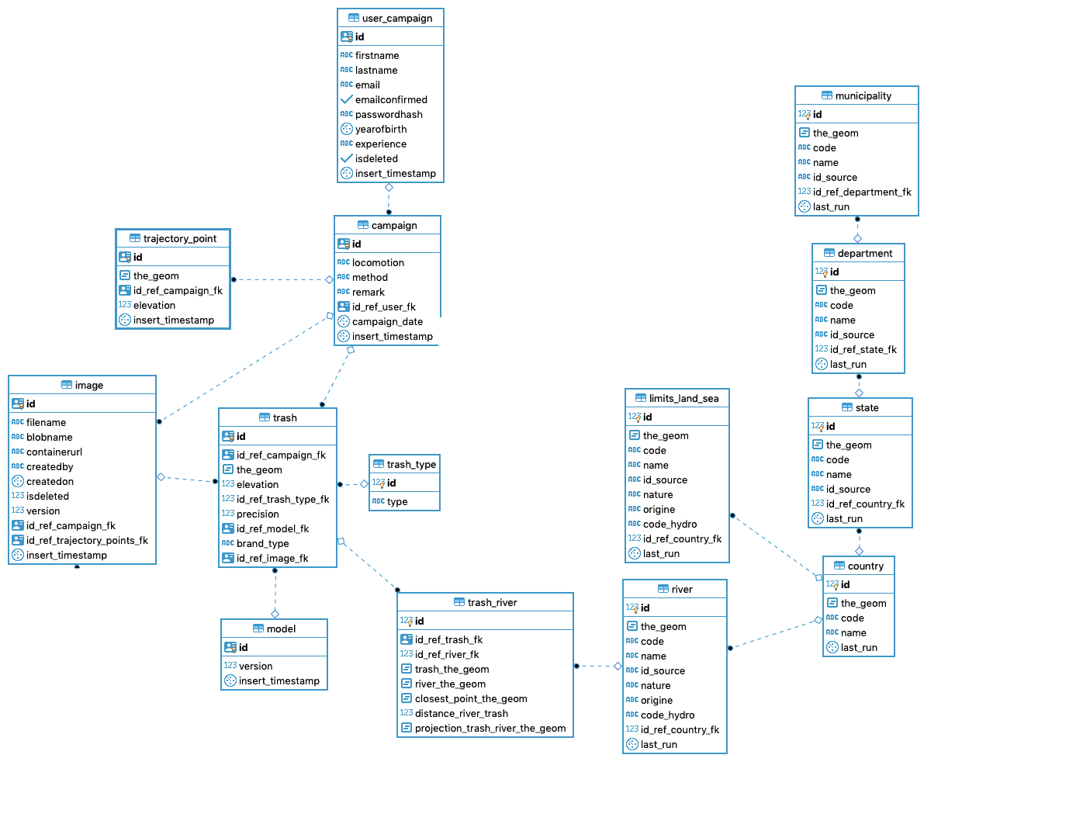
Write in DB
DB
GitHub repo:
https://github.com/surfriderfoundationeurope/plasticorigins-ops-db
https://github.com/surfriderfoundationeurope/powerbi-filldatabase
read

Slide 13
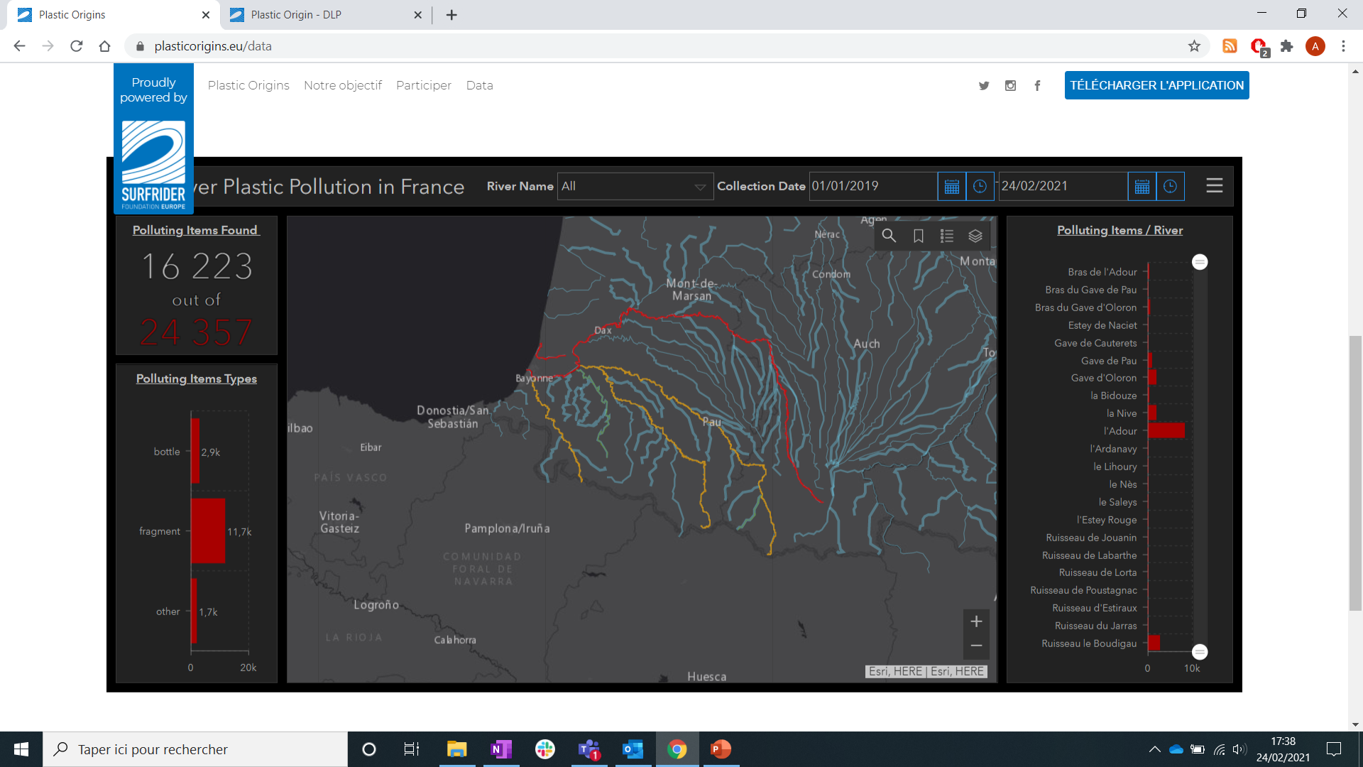
Read DB
Data visualisation
Embedded in website

Slide 14
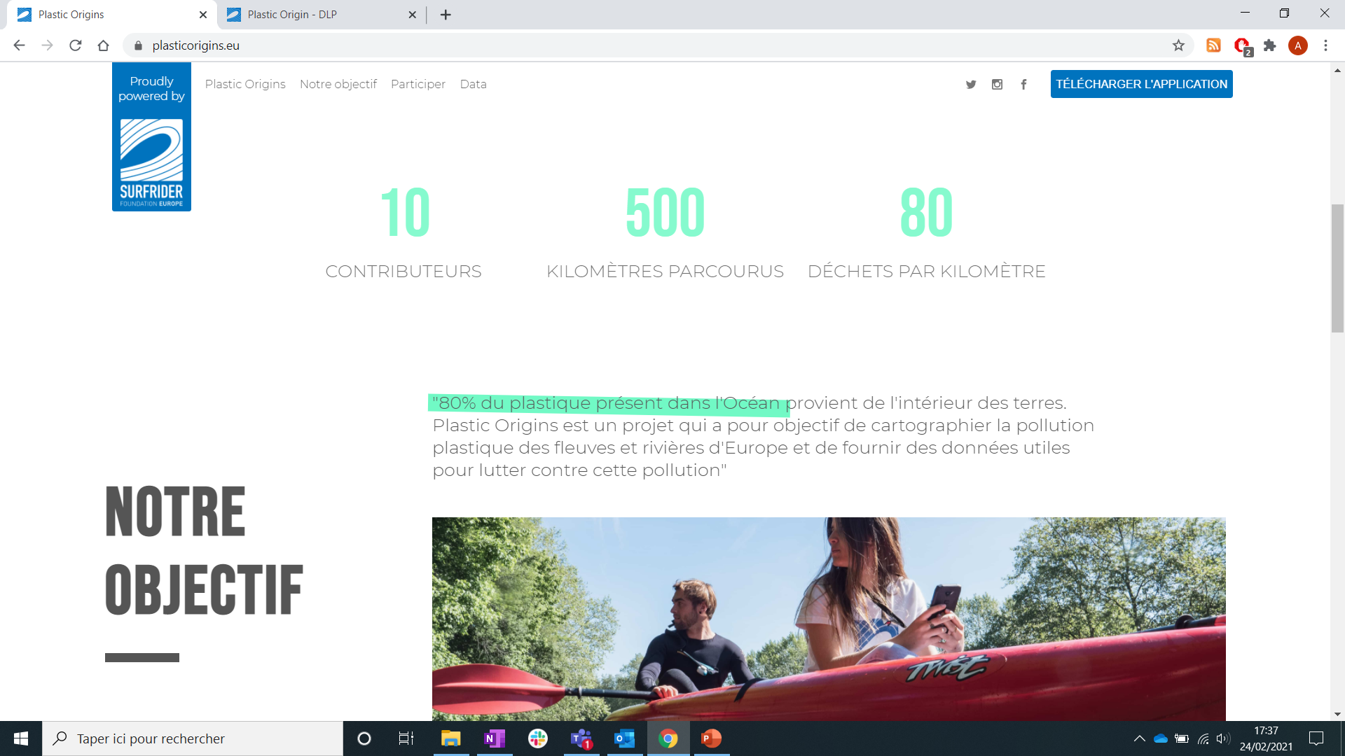
website
GitHub repo:
https://github.com/surfriderfoundationeurope/plastic-origin
Map embedded

Slide 15
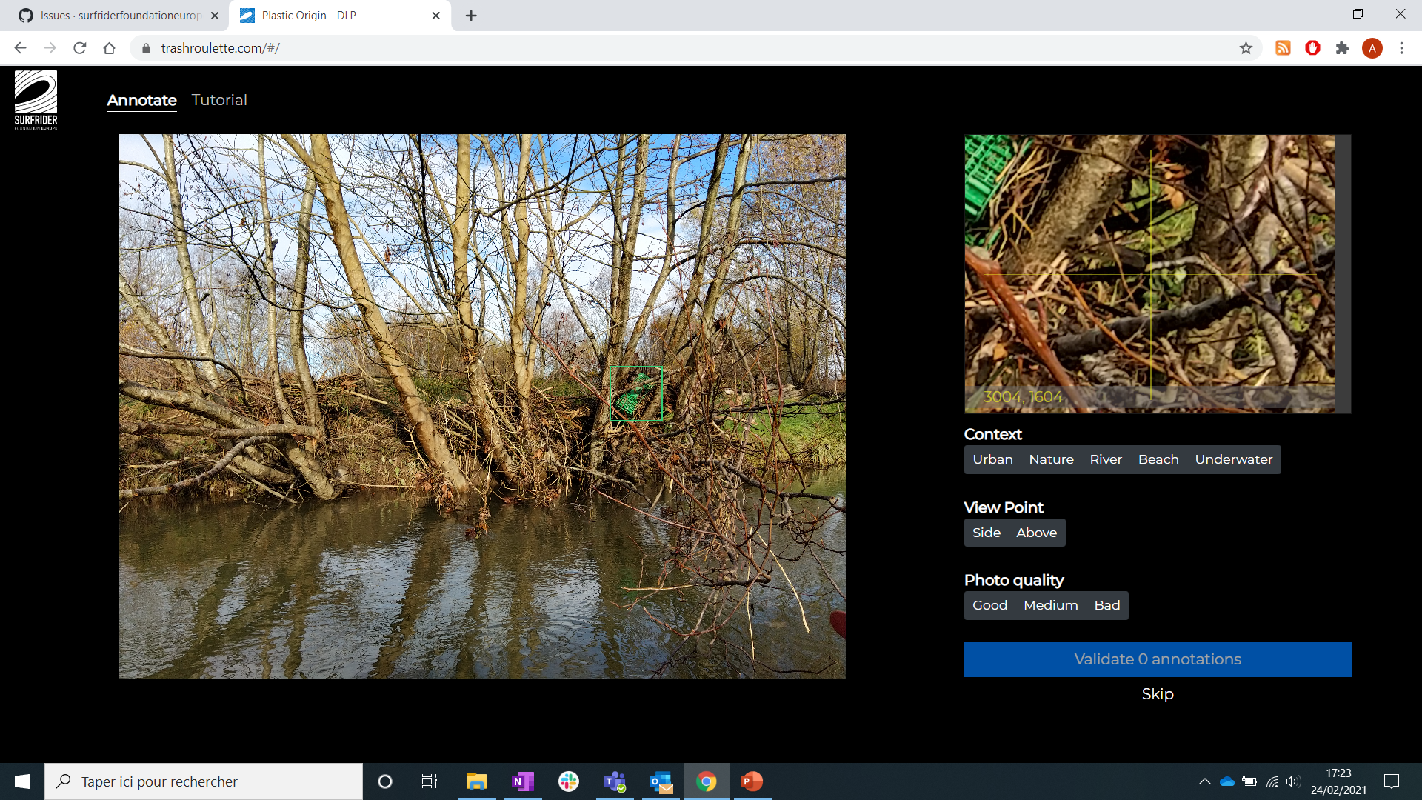
GitHub repo:
Front :
https://github.com/surfriderfoundationeurope/labelcv-web
Back :
https://github.com/surfriderfoundationeurope/po-mobile-backend
Data LABELING Platform
Provide labelled data to train AI

Slide 16
Supplementary slides

Slide 17
API MANAGEMENT
Repo:
https://github.com/surfriderfoundationeurope/plastic-origins-api-gateway
Team:
Lise Deguilhem
Next steps:
Help needed:
…

Slide 18
DevOps -> discussions / tasks / organisation du travail / build et déploiement
GitHub -> code + description du code + documentation + décision record Architectural decision record (ADR)

Slide 19
RIVER
River_id: guid
River_name: varchar(255)
River_Strahler_rank: (nombre <10)
RiverBasin
Lenght
Country
Modèle de données – v2
*
IMAGES
Id: guid
Campaign_id
Filename : varchar(max)
BlobName : varchar(max)
ContainerUrl : varchar(max)
Latitude : float
Longitude : float
Precision: float
1
???
0
1
*
CAMPAIGN
Id: guid
Campaign_id
Start_date: datetime2
End_date: datetime2
Start_Lat: float
Start_Long: float
EndLat: float
EndLong: float
Locomotion: {kayak, SUP, foot, motor boat, drone}
Method: {AI, Manual}
RiverSide: Boolean (1 for Left, 0 for Right}
Remark
ContainerURL
1
1
RIVER_COORD
River_id
Lat_coord: float
Lon_coord: float
Order: 1 to x (1 for the source, x for the river mouth)
*
*
TRASH
Id: guid
Campaign_id: guid
Latitude : float
Longitude : float
Precision: float
Type: {Unknow, Unknow10, Common Household Items, Drinking Bottles, Food Packaging, Agricultural Waste, Industrial or Construction Debris, Fishing or Hunting, Bottles, Fragments, Others}
Brand: {To be defined}
Image_id (null)
AI_Version: decimal (null)
IsDeleted (default FALSE – Boolean – not null)
1
USER
Id: guid
Firstname: varchar(255)
Lastname: varchar(255)
Email: varchar(255)
EmailConfirmed: varchar(255)
PasswordHash
YearOfBirth: int
HasBeenTrained: boolean
Role: {standard, admin, super admin}
IsDeleted
*
1

Slide 20
RIVER
River_id: guid
MeanDensityOfLitter
Modèle de données – v2
schema BI
*
IMAGES
1
0
1
*
???
CAMPAIGN
Id: guid
CampaignStartSeaDist
CampaignEndSeaDist
TotalDist
TotalLitter
LitterDensity
TotalUnknow
TotalUnknow10
TotalCommonHouseholdItems
TotalDrinkingBottles
TotalFoodPackaging
TotalAgriculturalWaste
TotalIndustrialOrConstructionDebris
TotalFishingAndHunting
TotalBottles
TotalFragments
TotalOthers
1
1
RIVER_COORD
River_id
SeaDist
*
TRASH
*
1
USER
Id: guid
TotalDist
NumberOfCampaign
*
1

Slide 21
Dimensionnement du volume de données
- GoPro – 2,4 Go pour une vidéo de 11 min sur 800m – 1080px 24fps
- Smartphone – 970 Mo pour une vidéo de 11 min sur 800m – 1080px 25fps
Sur cette base, on peut estimer que le poids moyen d’une vidéo de cette qualité est de 0,15 Go/min
Soit, si on vise 300 campagnes de 2h entre octobre 2020 et juin 2021, 5 400 Go de vidéo à stocker prises sur 2 600 km ce qui nous permet de mapper en moyenne 26 rivières (sur la base de 30% des rivières et longueur moyenne des rivières de 300 km)

